Slide 1


Pizza Sales Analysis

Slide 2
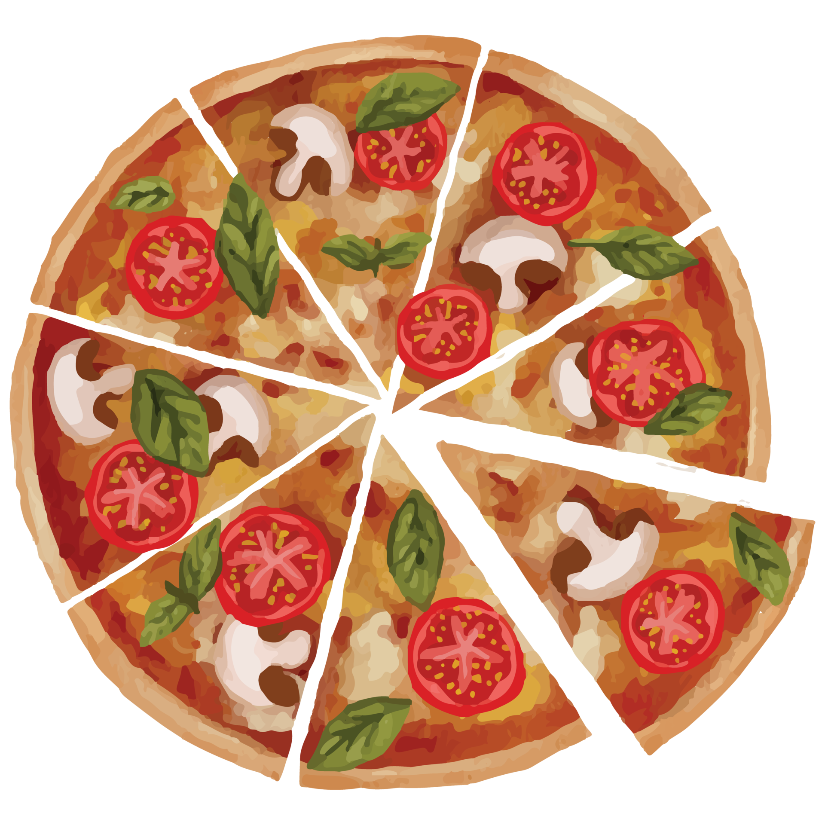
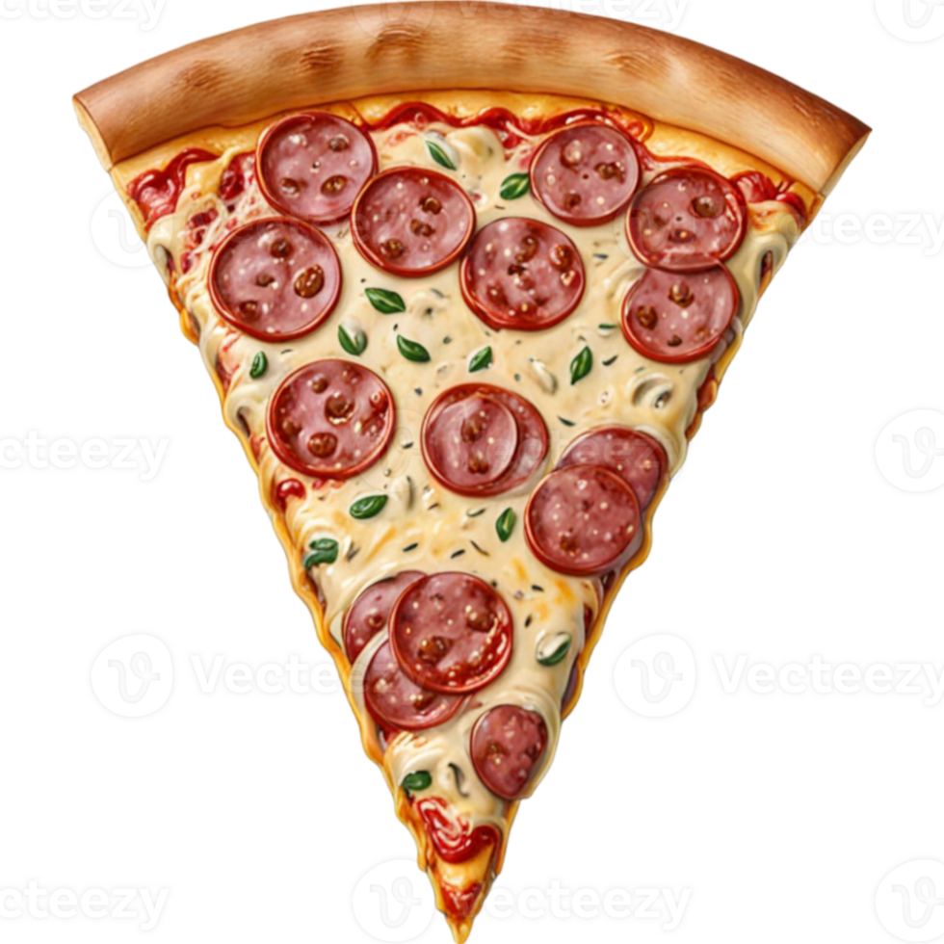
PROBLEM STATEMENT:-
KPI’S REQUIREMENTS:-
We need to analyze key indicators for our pizza sales data to gain insights into our business performance. Specifically, we want to calculate the following metrics:-
1.Total Revenue: The sum of the total price of all pizza orders.
2.Average Order Value: The average amount spent per order, calculated by dividing the
total revenue by the total number of orders.
3.Total Pizzas Sold: The sum of the quantities of all pizzas sold.
4.Total Orders: The total number of orders placed.
5.Average Pizzas Per Order: The average number of pizzas sold per order, calulated by
dividing the total number of pizzas sold by the total number of orders.

Slide 3
PROBLEM STATEMENT:-
CHARTS REQUIREMENT
We would like to visualize various aspects of our pizza sales data to gain insights and understand key trends. We have identified the following requirements for creating charts:
1.Daily Trend for Total Orders: Create a bar chart that displays the daily trend of total orders over a
specific time period. This chart will help us identify any patterns or fluctuations in order volumes on a
daily basis.
2.Monthly Trend for Total Orders: Create a line chart that illustrates the hourly trend of total orders
throughout the day. This chart will allow us to identify peak hours or periods of high order activity.
3.Percentage of Sales by Pizza Category: Create a ple chart that shows the distribution of sales across
different pizza categories. This chart will provide insights into the popularity of various pizza categories
and their contribution to overall sales.

Slide 4
PROBLEM STATEMENT:-
CHARTS REQUIREMENT
4.Percentage of Sales by Pizza Size: Generate a pie chart that represents the percentage of sales attributed
to different pizza sizes. This chart will help us understand customer preferences for pizza sizes and their
impact on sales.
5.Total Pizzas Sold by Pizza Category: Create a funnel chart that presents the total number of pizzas sold for
each pizza category. This chart will allow us to compare the sales performance of different pizza
categories.
6.Top 5 Best Sellers by Revenue,Total Quantity and Total Orders: Create a bar chart highlighting the top 5
best-selling pizzas based on the Revenue, Total Quantity, Total Orders. This chart will help us identify the
most popular pizza options.
7.Bottom 5 Best Sellers by Revenue,Total Quantity and Total Orders: Create a bar chart showcasing the
bottom 5 worst-selling pizzas based on the Revenue, Total Quantity, Total Orders. This chart will enable us
to identify underperforming or less popular pizza options.

Slide 5
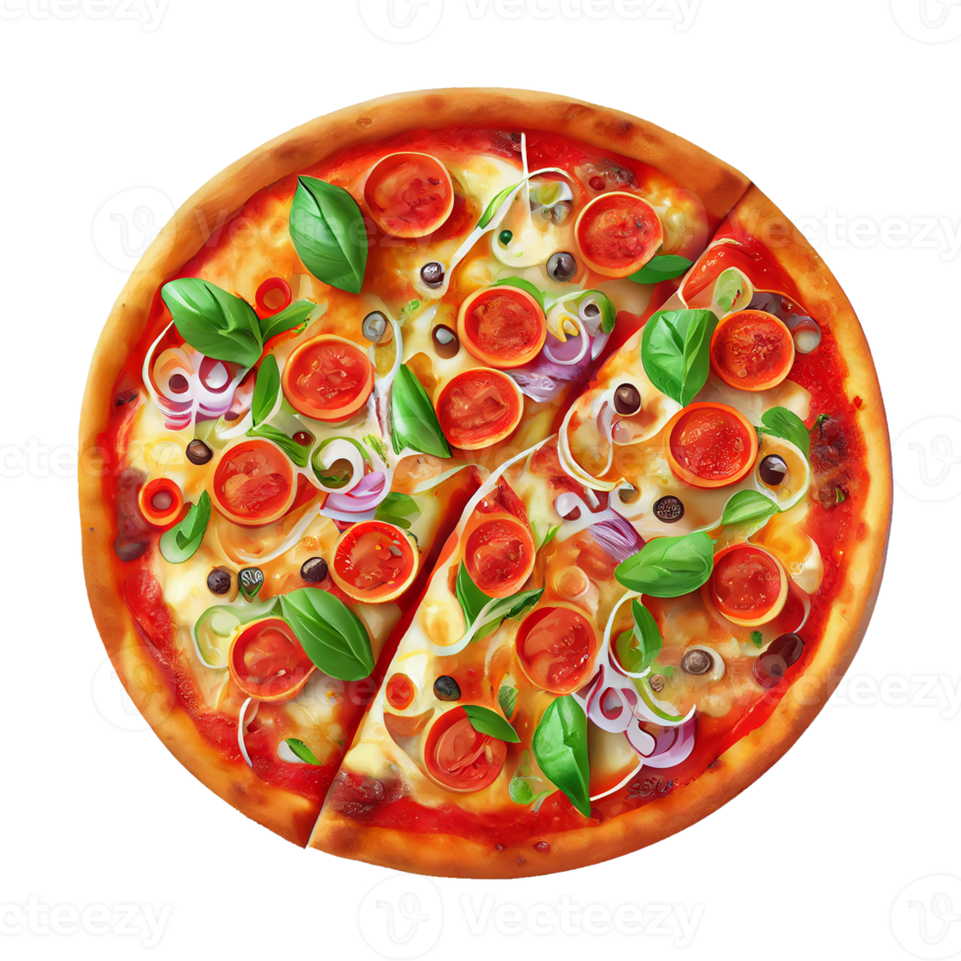
PROCESS:-
1.Data cleaning
2.Data processing
3.Data analysis
4.Data visualization
5.Data report
6.Insights and next steps

Slide 6
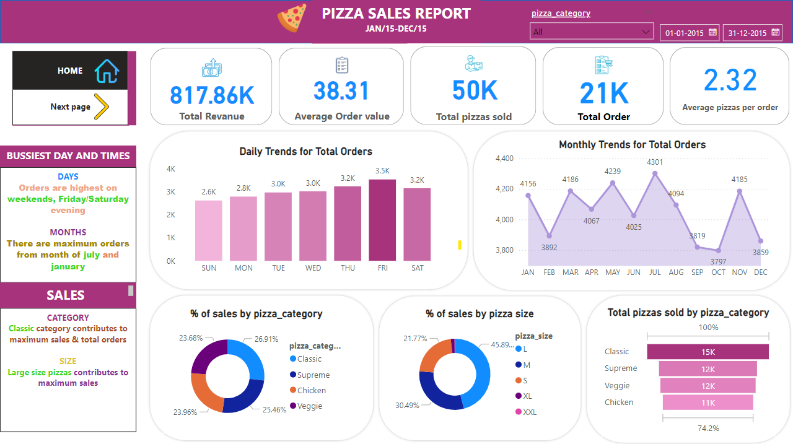

Slide 7
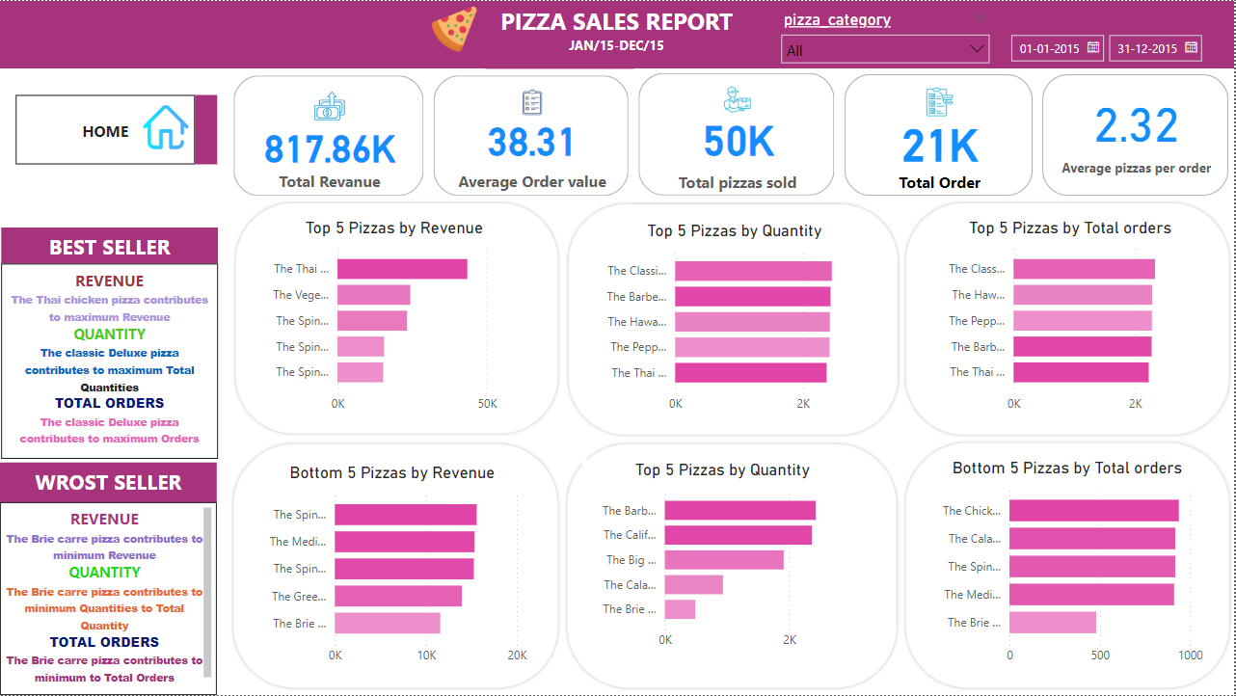

Slide 8
isheji-copy_1735566215318
INSIGHTS
BUSSIEST DAY AND TIME
In days Orders are highest on weekends, Friday and Saturday evening
In months the maximum orders from months of July and January
According to sales Classic categories contributes to maximum sales & total orders
According to size Large size pizzas contributes to maximum sales

Slide 9
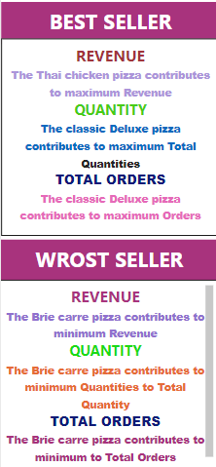
isheji-copy_1735566215318
INSIGHTS
BEST SELLER
In terms of revenue the thai chicken pizza contributes to maximum revenue
In terms of quantity the classic Delux pizza contributes to maximum total quantity
According orders the classic Delux pizza contributes to maximum orders
WROST SELLER
In terms of revenue the Brie pizza contributes to minimum revenue
In terms of quantity the Brie pizza contributes to minimum total quantity to total quantities
According orders the Brie pizza contributes to minimum to total orders

Slide 10
THE END
THANK YOU

